Slide 1
Artificial & Computational Intelligence
AIMLCZG557
Contributors & Designers of document content : Cluster Course Faculty Team
M4 : Knowledge Representation Using Logics
Presented by
Faculty Name
BITS Email ID

Slide 2

Artificial and Computational Intelligence
Disclaimer and Acknowledgement
Few content for these slides may have been obtained from prescribed books and various other source on the Internet
I hereby acknowledge all the contributors for their material and inputs and gratefully acknowledge people others who made their course materials freely available online.
.I have provided source information wherever necessary
This is not a full fledged reading materials. Students are requested to refer to the textbook w.r.t detailed content of the presentation deck that is expected to be shared over e-learning portal - taxilla.
I have added and modified the content to suit the requirements of the class dynamics & live session’s lecture delivery flow for presentation
Slide Source / Preparation / Review:
From BITS Pilani WILP: Prof.Raja vadhana, Prof. Indumathi, Prof.Sangeetha
From BITS Oncampus & External : Mr.Santosh GSK

Slide 3

Course Plan
M1 | Introduction to AI
M2 | Problem Solving Agent using Search
M3 | Game Playing
M4 | Knowledge Representation using Logics
M5 | Probabilistic Representation and Reasoning
M6 | Reasoning over time
M7 | Ethics in AI
BITS Pilani, Pilani Campus

Slide 4

Knowledge Representation Using Logics
BITS Pilani, Deemed to be University under Section 3 of UGC Act, 1956

Slide 5
Learning Objective
At the end of this class , students Should be able to:
Represent a given knowledge base into logic formulation
Infer facts from KB using Resolution
Infer facts from KB using Forward Chaining
Infer facts from KB using Backward Chaining

Slide 6
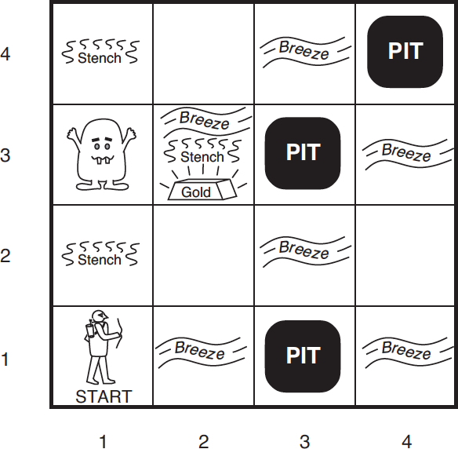
Knowledge based Agent : Model & Represent
Concepts,logicRepresentationofa sampleagent
Wumpus World Problem:
PEAS:
Performance Measure:
+1000 for climbing out with gold,
-1000 for falling into a pit or being eaten by
Wumpus,
-1 for each action taken and
-10 for using an arrow
Environment: 4x4 grid of rooms. Always starts at
[1, 1] facing right.
The location of Wumpus and Gold are random.
Agent dies if entered a pit or live Wumpus.

Slide 7
Knowledge based Agent : Model & Represent
Concepts,logicRepresentationofa sampleagent
Wumpus World Problem:
PEAS:
Actuators – Forward, TurnLeft by 90,
TurnRight by 90,
Grab – pick gold if present,
Shoot – fire an arrow, it either hits a wall or kills
wumpus. Agent has only one arrow.
Climb – Used to climb out of cave, only from [1,
1]

Slide 8
Knowledge based Agent : Model & Represent
Concepts,logicRepresentationofa sampleagent
Why do we need Factored representation
To reason about steps
To learn new knowledge about the
environment
To adapt to changes to the existing
knowledge
Accept new tasks in the form of explicit goals
To overcome partial observability of
environment

Slide 9
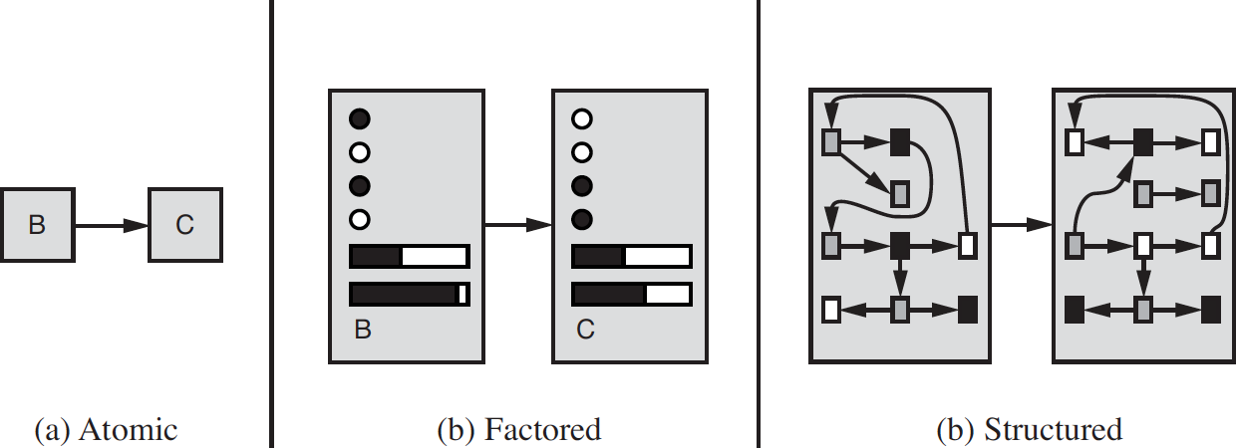
Representation
Agents based on Propositional logic,TT-Entail forinference from truth table
Syntax Semantics Model
Propositional Logic
Logic
Predicate Logic
Search Strategies
Propositional Logic
First Order Logic

Slide 10
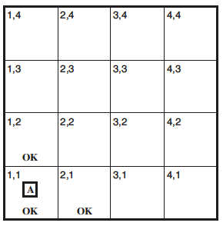
Propositional Logic
Agentsbasedon Propositionallogic,TT-Entailforinferencefromtruthtable
A simple representation language for building knowledge-based agents
Proposition Symbol – A symbol that stands for a proposition.
E.g., W1,3 – “Wumpus in [1,3]” is a proposition and W1,3 is the symbol
Proposition can be true or false
Atomic : W_{1,3} Conjuncts : W_{1,3} ⋀ P_{3,1} Disjuncts : W_{1,3} ⋁ P_{3,1} Implications :
^{(W}1,3 ^{⋀ P}3,1^{) ⟹ ¬ W}2,2
Biconditional : W_{1,3} ⟺ ¬ W_{2,2}

Slide 11
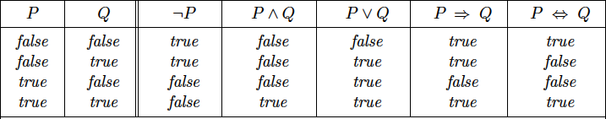
Propositional Logic
Agentsbasedon Propositionallogic,TT-Entailforinferencefromtruthtable
Tie break in search:
¬ , ⋀ , ⋁, ⟹ , ⟺
(¬ A) ⋀ 𝐵 has precedence over ¬ (A ⋀ 𝐵)

Slide 12
Knowledge based Agent : Model & Represent
Concepts,logicRepresentationofa sampleagent
Wumpus World Problem:
PEAS:
Sensors. The agent has five sensors
Stench: In all adjacent (but not diagonal) squares of Wumpus
Breeze: In all adjacent (but not diagonal)
squares of a pit
Glitter: In the square where gold is
Bump: If agent walks into a wall
Scream: When Wumpus is killed, it can be
perceived everywhere
Percept Format:
[Stench?, Breeze?, Glitter?, Bump?, Scream?]
E.g., [Stench, Breeze, None, None, None]

Slide 13
Percept 1: [None, None, None, None, None]
Action: Forward
Percept Format:
[Stench?, Breeze?, Glitter?, Bump?, Scream?]

Slide 14
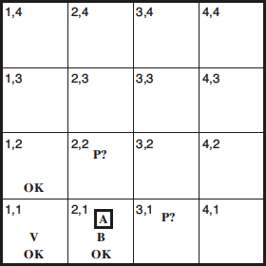
Percept 2: [None , Breeze, None, None, None, None]

Slide 15
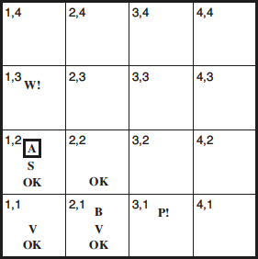
Percept 3: [Stench, None, None, None, None]
Action: Move to [2, 2]
Remembers (2,2) as possible PIT and no Stench.

Slide 16
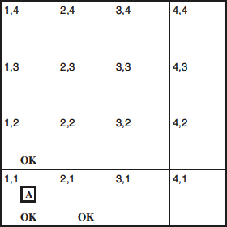
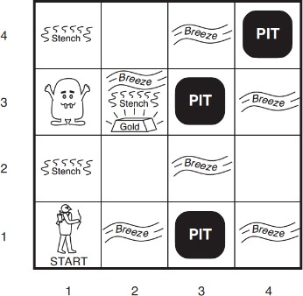
Representation by Propositional Logic
For each [x, y] location
P_{x,y} is true if there is a pit in [x, y]
W_{x,y} is true if there is a wumpus in [x, y]
B_{x,y} is true if agent perceives a breeze in [x, y]
S_{x,y} is true if agent perceives a stench in [x, y]
------------------------ R is the sentence in KB
R₁ : ¬ P_{1,1}
^{R}2 ^{: B}1,1 ^{⟺ (P}1,2 ^{⋁ P}2,1⁾
^{R}3 ^{: B}2,1 ^{⟺ (P}1,1 ^{⋁ P}2,2 ^{⋁ P}3,1 ⁾
R₄ : ¬ B_{1,1}
^{R}5 ^{: B}2,1
𝑄𝑢𝑒𝑟𝑦 ∶ ¬ P_{1,2} entailed by our KB?

Slide 17
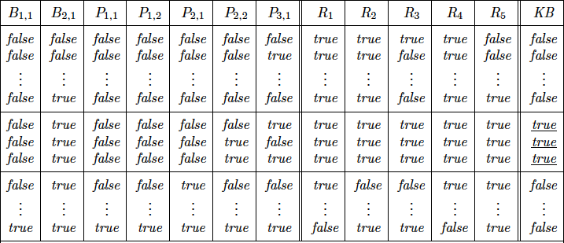
TT – Entails Inference – Example
Agentsbasedon Propositionallogic,TT-Entailforinferencefromtruthtable
¬ P_{1,2} entailed by our KB?
Way – 1 :
Get sufficient information B_{1,1}, B_{2,1}, P_{1,1}, P_{1,2}, P_{2,1}, P_{2,2}, P_{3,1}
Enumerate all models with combination of truth values to propositional
symbols
In all the models, find those models where KB is true, i.e., every sentence R₁, R₂, R₃, R₄, R₅ are true
In those models where KB is true, find if query sentence ¬ P_{1,2} is true
If query sentence ¬ P_{1,2} is true in all models where KB is true, then it entails, otherwise it won’t

Slide 18
TT – Entails Inference – Example
Agentsbasedon Propositionallogic,TT-Entailforinferencefromtruthtable

Slide 19
Inference : Properties
Entailment : α ╞ β
Equivalence : α ≡ β if and only if α ╞ β and β ╞ α
Validity
Satisfiability

Slide 20
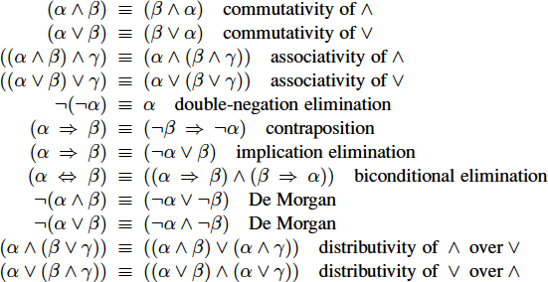
Inference : Example – Theorem Proving (Self Study)
Propositional theorem proving -Proof by resolution
Logical Equivalence rules can be used as inference rules

Slide 21
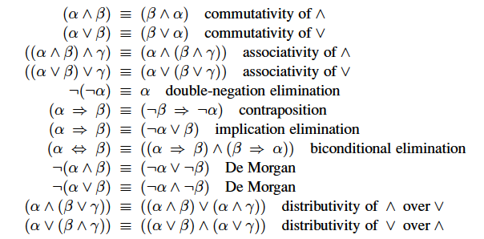
Inference : Example – Theorem Proving
Modes Ponens
AND Elimination
α : I walk in rain without the umbrella
β : I get wet
α → β α
.
β

Slide 22
Inference : Example – Theorem Proving
Modes Ponens
AND Elimination
α : I walk in rain without the umbrella
β : I get wet
α 𝖠 β
.
α
β

Slide 23
Inference : Example – Theorem Proving
R₁ : ¬ P_{1,1}
^{R}2 ^{: B}1,1 ^{⟺ (P}1,2 ^{⋁ P}2,1⁾
^{R}3 ^{: B}2,1 ^{⟺ (P}1,1 ^{⋁ P}2,2 ^{⋁ P}3,1 ⁾ R₄ : ¬ B_{1,1}
^{R}5 ^{: B}2,1
Query: ¬ P_{1,2} . Can we prove if this sentence be entailed from KB using
inference rules?
^{R}2 ^{: B}1,1 ^{⟺ (P}1,2 ^{⋁ P}2,1⁾
R₆ : (B_{1,1} ⟹ (P_{1,2} ⋁ P_{2,1})) ⋀ ((P_{1,2} ⋁ P_{2,1}) ⟹ B_{1,1})
R₇ : ((P_{1,2} ⋁ P_{2,1}) ⟹ B_{1,1})
R₈ : (¬ B_{1,1} ⟹ ¬ (P_{1,2} ⋁ P_{2,1}))
R₉ : ¬ (P_{1,2} ⋁ P_{2,1})
^{R}10 ^{: ¬ P}1,2 ^{⋀ ¬ P}2,1
R11: ¬ P_{1,2}
Biconditional Elimination And Elimination Contraposition
Modus Ponens
Demorgans
And Elimination

Slide 24
Propositional Logic
Proof by Contradiction
Inference = FALSE
Inference =
TRUE
Assumption is
False
Assumption is
TRUE
Given Query is
TRUE
Given Query is FALSE

Slide 25
PL-Resolution
Horn Clause
Definite Clause : A horn clause with exactly one
positive literal
Fact : Definite clause with no negative literal / assertion
Rule
Inference by Chaining

Slide 26
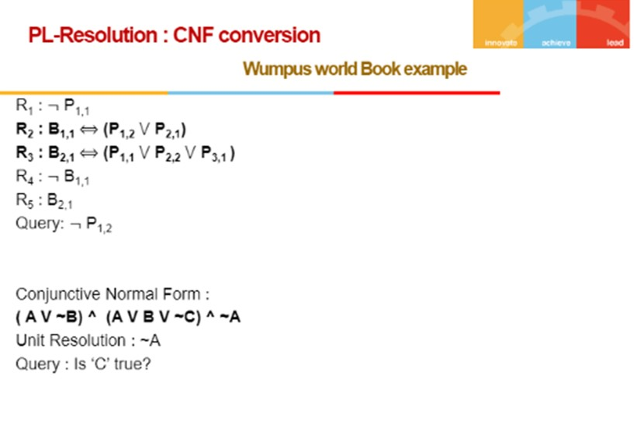

Slide 28
PL-Resolution
R₁ : ¬ P_{1,1}
R₂ : B_{1,1} ⟺ (P_{1,2} ⋁ P_{2,1})
R₃ : B_{2,1} ⟺ (P_{1,1} ⋁ P_{2,2} ⋁ P_{3,1} )
R₄ : ¬ B_{1,1}
^{R}5 ^{: B}2,1
Query: ¬ P_{1,2}
^{R}6 ^{: ¬B}1,1 ^{⋁ P}1,2 ^{⋁ P}2,1
^{R}7 ^{: ¬P}1,2^{⋁ B}1,1
^{R}8 ^{: ¬P}2,1 ^{⋁ B}1,1
^{R}9 ^{: ¬B}2,1 ^{⋁ P}1,1 ^{⋁ P}2,2^{⋁ P}3,1 ^{R}10 ^{: ¬P}1,1^{⋁B}2,1
^{R}11 ^{: ¬P}2,2^{⋁ B}2,1 ^{R}12 ^{: ¬P}3,1^{⋁ B}2,1
Eliminate |  | ^{R}2 ^{: B}1,1 ^{⟺ (P}1,2 ^{⋁ P}2,1⁾ | ^{R}3 ^{: B}2,1 ^{⟺ (P}1,1 ^{⋁ P}2,2 ^{⋁ P}3,1 ⁾
←→ | Biconditional Elimination | (B_{1,1} ⟹ (P_{1,2} ⋁ P_{2,1})) ⋀ ((P_{1,2} ⋁ ^{P}2,1^{) ⟹ B}1,1⁾ | (B_{2,1} ⟹ (P_{1,1} ⋁ P_{2,2}⋁ P_{3,1})) ⋀ ((P_{1,1} ⋁ ^{P}2,2^{⋁ P}3,1^{) ⟹ B}2,1⁾
→ | Implication Elimination | ^{¬B}1,1 ^{⋁ (P}1,2 ^{⋁ P}2,1⁾ ^{¬(P}1,2 ^{⋁ P}2,1^{) ⋁ B}1,1 | ^{¬B}2,1 ^{⋁ (P}1,1 ^{⋁ P}2,2^{⋁ P}3,1⁾ ^{¬(P}1,1 ^{⋁ P}2,2^{⋁ P}3,1^{) ⋁ B}2,1
Clause level ¬ | De Morgan | (¬P_{1,2}⋀¬P_{2,1}) ⋁ B_{1,1} | (¬P_{1,1}⋀¬P_{2,2}⋀¬P_{3,1}) ⋁ B_{2,1}
CNF Form | Distributivity of V over ⋀ | (¬P_{1,2}⋁ B_{1,1}) ⋀(¬P_{2,1} ⋁ B_{1,1}) | (¬P_{1,1}⋁B_{2,1}) ⋀(¬P_{2,2}⋁ B_{2,1}) ⋀ (¬P_{3,1}⋁ B_{2,1})
BITS Pilani, Pilani Campus

Slide 29
PL-Resolution
R₁ : ¬ P_{1,1}
R₂ : B_{1,1} ⟺ (P_{1,2} ⋁ P_{2,1})
R₃ : B_{2,1} ⟺ (P_{1,1} ⋁ P_{2,2} ⋁ P_{3,1} )
R₄ : ¬ B_{1,1}
^{R}5 ^{: B}2,1
Query: ¬ P_{1,2}
^{R}6 ^{: ¬B}1,1 ^{⋁ P}1,2 ^{⋁ P}2,1
^{R}7 ^{: ¬P}1,2^{⋁ B}1,1
^{R}8 ^{: ¬P}2,1 ^{⋁ B}1,1
^{R}9 ^{: ¬B}2,1 ^{⋁ P}1,1 ^{⋁ P}2,2^{⋁ P}3,1 ^{R}10 ^{: ¬P}1,1^{⋁B}2,1
^{R}11 ^{: ¬P}2,2^{⋁ B}2,1 ^{R}12 ^{: ¬P}3,1^{⋁ B}2,1
Eliminate |  | ^{R}2 ^{: B}1,1 ^{⟺ (P}1,2 ^{⋁ P}2,1⁾ | ^{R}3 ^{: B}2,1 ^{⟺ (P}1,1 ^{⋁ P}2,2 ^{⋁ P}3,1 ⁾
←→ | Biconditional Elimination | (B_{1,1} ⟹ (P_{1,2} ⋁ P_{2,1})) ⋀ ((P_{1,2} ⋁ ^{P}2,1^{) ⟹ B}1,1⁾ | (B_{2,1} ⟹ (P_{1,1} ⋁ P_{2,2}⋁ P_{3,1})) ⋀ ((P_{1,1} ⋁ ^{P}2,2^{⋁ P}3,1^{) ⟹ B}2,1⁾
→ | Implication Elimination | ^{¬B}1,1 ^{⋁ (P}1,2 ^{⋁ P}2,1⁾ ^{¬(P}1,2 ^{⋁ P}2,1^{) ⋁ B}1,1 | ^{¬B}2,1 ^{⋁ (P}1,1 ^{⋁ P}2,2^{⋁ P}3,1⁾ ^{¬(P}1,1 ^{⋁ P}2,2^{⋁ P}3,1^{) ⋁ B}2,1
BITS Pilani, Pilani Campus

Slide 30
PL-Resolution
Unit Resolution: Query: ¬ P_{1,2}
To find: Is there a pit in location (1,2) using the CNF obtained in previous slide
Inference = FALSE
Assumption is False
Given Query is
TRUE
R₁ : ¬ P_{1,1}
R₂ : B_{1,1} ⟺ (P_{1,2} ⋁ P_{2,1})
R₃ : B_{2,1} ⟺ (P_{1,1} ⋁ P_{2,2} ⋁ P_{3,1} )
R₄ : ¬ B_{1,1}
^{R}5 ^{: B}2,1
Query: ¬ P_{1,2}
^{R}6 ^{: ¬B}1,1 ^{⋁ P}1,2 ^{⋁ P}2,1
^{R}7 ^{: ¬P}1,2^{⋁ B}1,1
^{R}8 ^{: ¬P}2,1 ^{⋁ B}1,1
^{R}9 ^{: ¬B}2,1 ^{⋁ P}1,1 ^{⋁ P}2,2^{⋁ P}3,1 ^{R}10 ^{: ¬P}1,1^{⋁B}2,1
^{R}11 ^{: ¬P}2,2^{⋁ B}2,1 ^{R}12 ^{: ¬P}3,1^{⋁ B}2,1

Slide 31
PL-Resolution
Unit Resolution: Query: ¬ P_{1,2}
To find: Is there a pit in location (1,2) using the CNF obtained in previous slide
Inference = FALSE
Assumption is False
^{¬ B}1,1
^{¬P}1,2 ^{⋁ B}1,1
Given Query is
TRUE
^{P}1,2
^{¬P}1,2
{ }

Slide 32
DPLL Algorithm
In logic and computer science, the Davis–Putnam–Logemann–Loveland (DPLL) algorithm is a complete, backtracking-based search algorithm for deciding the satisfiability of propositional logic formulae in conjunctive normal form
Improvements:
Early Termination
Pure Symbolic Heuristic
Unit Clause Heuristic

Slide 33
DPLL Algorithm
In logic and computer science, the Davis–Putnam–Logemann–Loveland (DPLL) algorithm is a complete, backtracking-based search algorithm for deciding the satisfiability of propositional logic formulae in conjunctive normal form
Improvements:
Early Termination
Pure Symbolic Heuristic
Unit Clause Heuristic

Slide 34
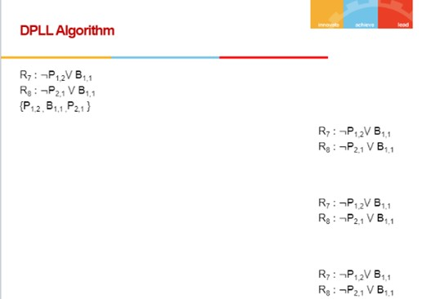
P1,2
True
False
B1,1
False
True
R7 is not true .
Hence backtrack
P2,1
True
All premises satisfied in this DFS path. Returns result

Slide 35
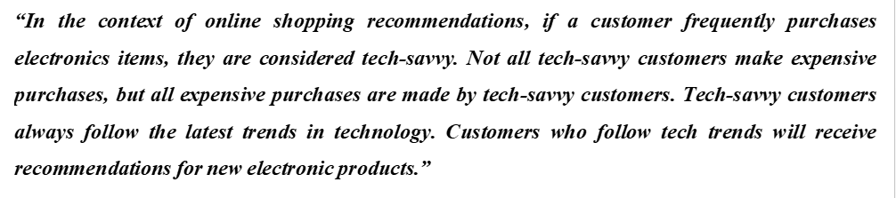
Sample Problem :
Use propositional logic (without quantifiers) to efficiently represent the knowledge base given above.
W.r.t the knowledge base from part (a), convert it into Conjunctive Normal Form (CNF) and find one sample complete Binary Satisfiability (BSAT) solution to the variables using the DPLL algorithm.
Suppose a customer is known to frequently purchase electronics but has ruled out being tech-savvy (¬T) with 100% certainty. Under this scenario, if the logic agent is asked, "Is the customer likely to receive recommendations for new electronic products?" how does the agent reason to answer the query? Prove by contradiction using the results obtained in part (a) by the resolution method.

Slide 36
Towards Predicate Logic
All courses are offered and interesting
All offered courses are interesting
Some of the courses are offered and interesting [Atleast one of the offered
courses is interesting]
Some of the offered courses are interesting

Slide 37
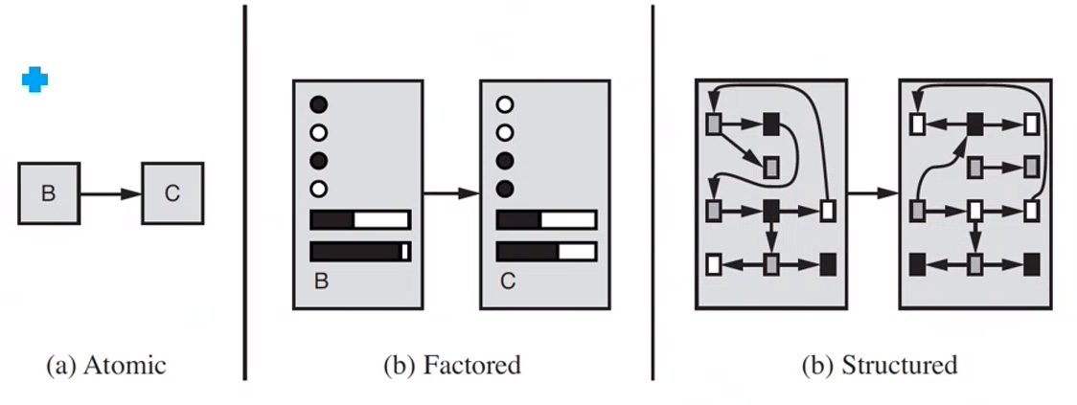
Towards Predicate Logic

Slide 38
Predicate Logic
Squares neighboring the wumpus are smelly
Objects: squares, wumpus
Unary Relation (properties of an object): smelly N-ary Relation (between objects): neighboring
Function: -
Primary difference between propositional and first-order logic lies in “ontological commitment” – the assumption about the nature of reality.

Slide 39
Predicate Logic – Sample Modelling
“Squares neighboring the wumpus are smelly”
∀𝑥,y Neighbour(𝑥,y ) ⋀ Wumpus(y)⟹Smelly(𝑥)
Order of quantifiers is important

Slide 40
Predicate Logic – Sample Modelling
“Everybody loves somebody”
∀𝑥 ∃𝑦 𝐿𝑜𝑣𝑒𝑠(𝑥, 𝑦)
“There is someone who is loved by everyone”
∃𝑦 ∀𝑥 𝐿𝑜𝑣𝑒𝑠(𝑥, 𝑦)
Order of quantifiers is important

Slide 41
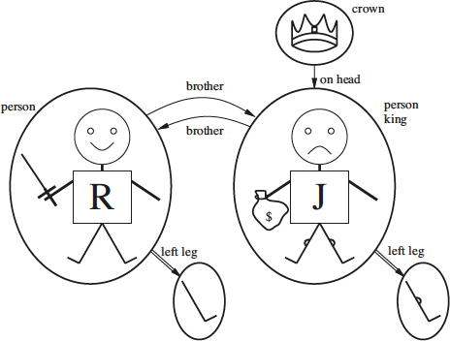
Predicate Logic – Sample Modelling
Brother(Richard, John) ⋀ Brother(John, Richard)
King(Richard) ⋁ King(John)
¬King(Richard) ⟹ King(John)

Slide 42
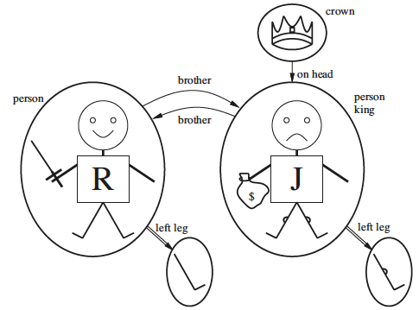
Predicate Logic – Sample Modelling Quantifiers
Brother(Richard, John) ⋀ Brother(John, Richard)
King(Richard) ⋁ King(John)
¬King(Richard) ⟹ King(John)
”All Kings are persons”
∀𝑥 𝐾𝑖𝑛𝑔(𝑥)⟹𝑃𝑒𝑟𝑠𝑜𝑛(𝑥)
“King John has a crown on his head”
∃𝑥 𝐶𝑟𝑜𝑤𝑛(𝑥) 𝖠𝑂𝑛𝐻𝑒𝑎𝑑(𝑥, 𝐽𝑜ℎ𝑛)
Ground Term: A term with no variables. E.g., King(Richard)

Slide 43
Predicate Logic – Inference
Substitute for Quantifiers
Convert into Propositional Logic
Apply inference tech
∀𝑥 𝐾𝑖𝑛𝑔(𝑥)⟹𝑃𝑒𝑟𝑠𝑜𝑛(𝑥)
Richard the Lionheart is a king ⟹ Richard the Lionheart is a person
King John is a king ⟹ King John is a person
∃𝑥 𝐶𝑟𝑜𝑤𝑛(𝑥) 𝖠𝑂𝑛𝐻𝑒𝑎𝑑(𝑥, 𝐽𝑜ℎ𝑛)
Crown(C₁) 𝖠 OnHead(C₁, John)
||C1 is imputed assumed fact

Slide 44
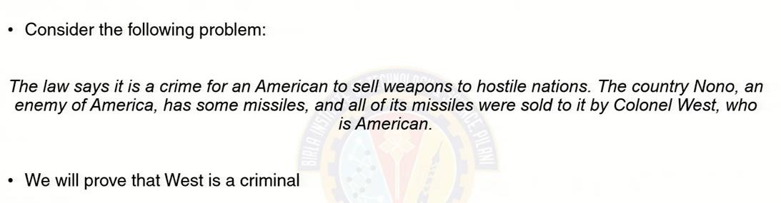
Forward Chaining

Slide 45
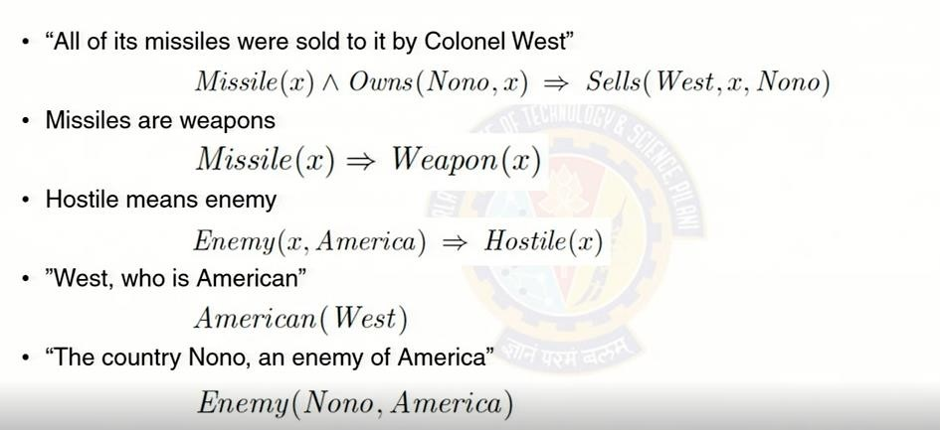
Forward Chaining

Slide 46
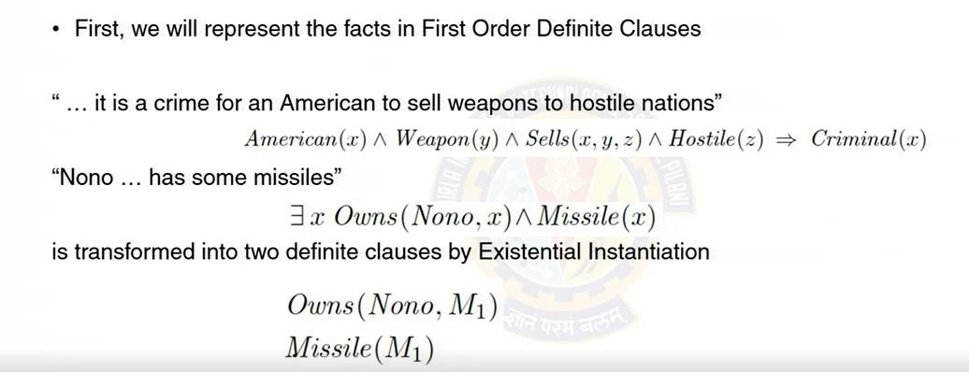
Forward Chaining

Slide 47
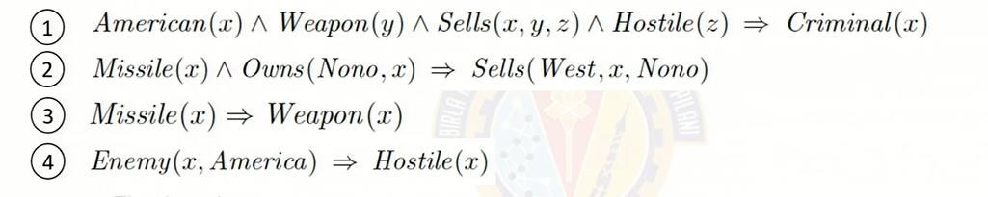
Forward Chaining
Missile(M1) Owns(Nono, M1) American (West) Enemy (Nono, America)

Slide 48
Forward Chaining
Algorithm:
Start from the facts
Trigger all rules whose premises are satisfied
Add the conclusion to known facts
Repeat the steps till no new facts are added or the query is answered

Slide 49
Forward Chaining
Missile(M1) Owns(Nono, M1) American (West) Enemy (Nono, America)

Slide 50
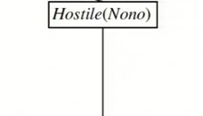
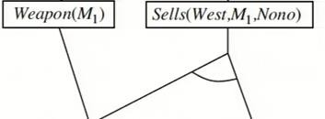
Forward Chaining
Missile(M1) Owns(Nono, M1) American (West) Enemy (Nono, America)

Slide 51
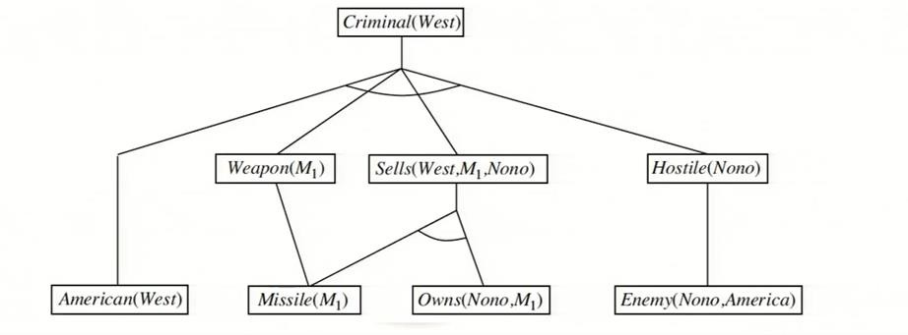
Forward Chaining

Slide 52
Forward Chaining
Algorithm:
Start from the facts - Conjunct Ordering
Trigger all rules whose premises are satisfied - Pattern Matching
Add the conclusion to known facts – Irrelevant Facts
Repeat the steps till no new facts are added or the query is answered – Redundant Rule Matching

Slide 53

Algorithm:
Form Definite Clause
Start from the Goals
Search through rules to find the fact that support the proof
If it stops in the fact which is to be proved → Empty Set- LHS
Divide & Conquer Strategy
Substitution by Unification

Slide 54
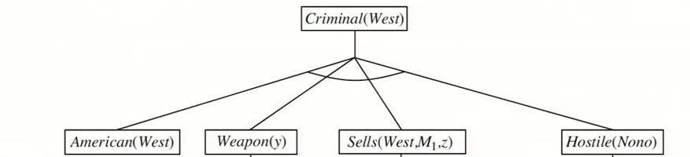
Missile(M1) Owns(Nono, M1) American (West) Enemy (Nono, America)

Slide 55
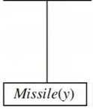
Missile(M1) Owns(Nono, M1) American (West) Enemy (Nono, America)

Slide 56
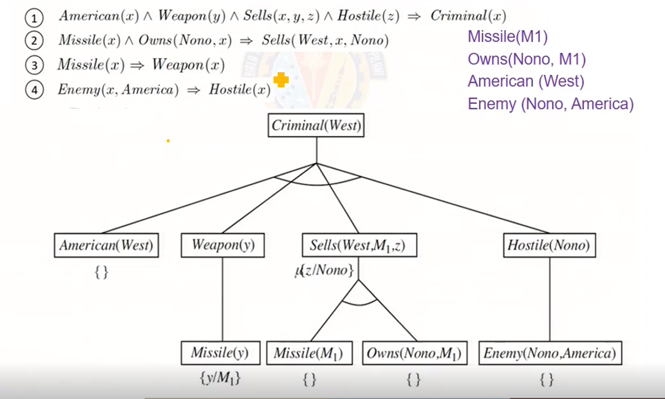

Slide 58

Required Reading: AIMA - Chapter # 4.1, #4.2, #5.1, #9
Next Session Plan:
- (Prerequisite Reading : Refresh the basics of probability , Bayes Theorem , Conditional Probability, Product Rule, Conditional Independence, Chain Rule)
Inferences using Logic ( Forward / Backward Chaining / DPLL algorithm)
Bayesian Network
Representation
Inferences (Exact and approximate-only Direct sampling)
Thank You for all your Attention
Note : Some of the slides are adopted from AIMA TB materials
BITS Pilani, Deemed to be University under SBeIcTtSionPi3laonfi,UPGilaCnAi Ccta, m19p5u6s

